Slide 1
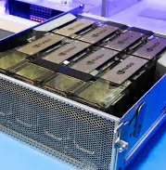
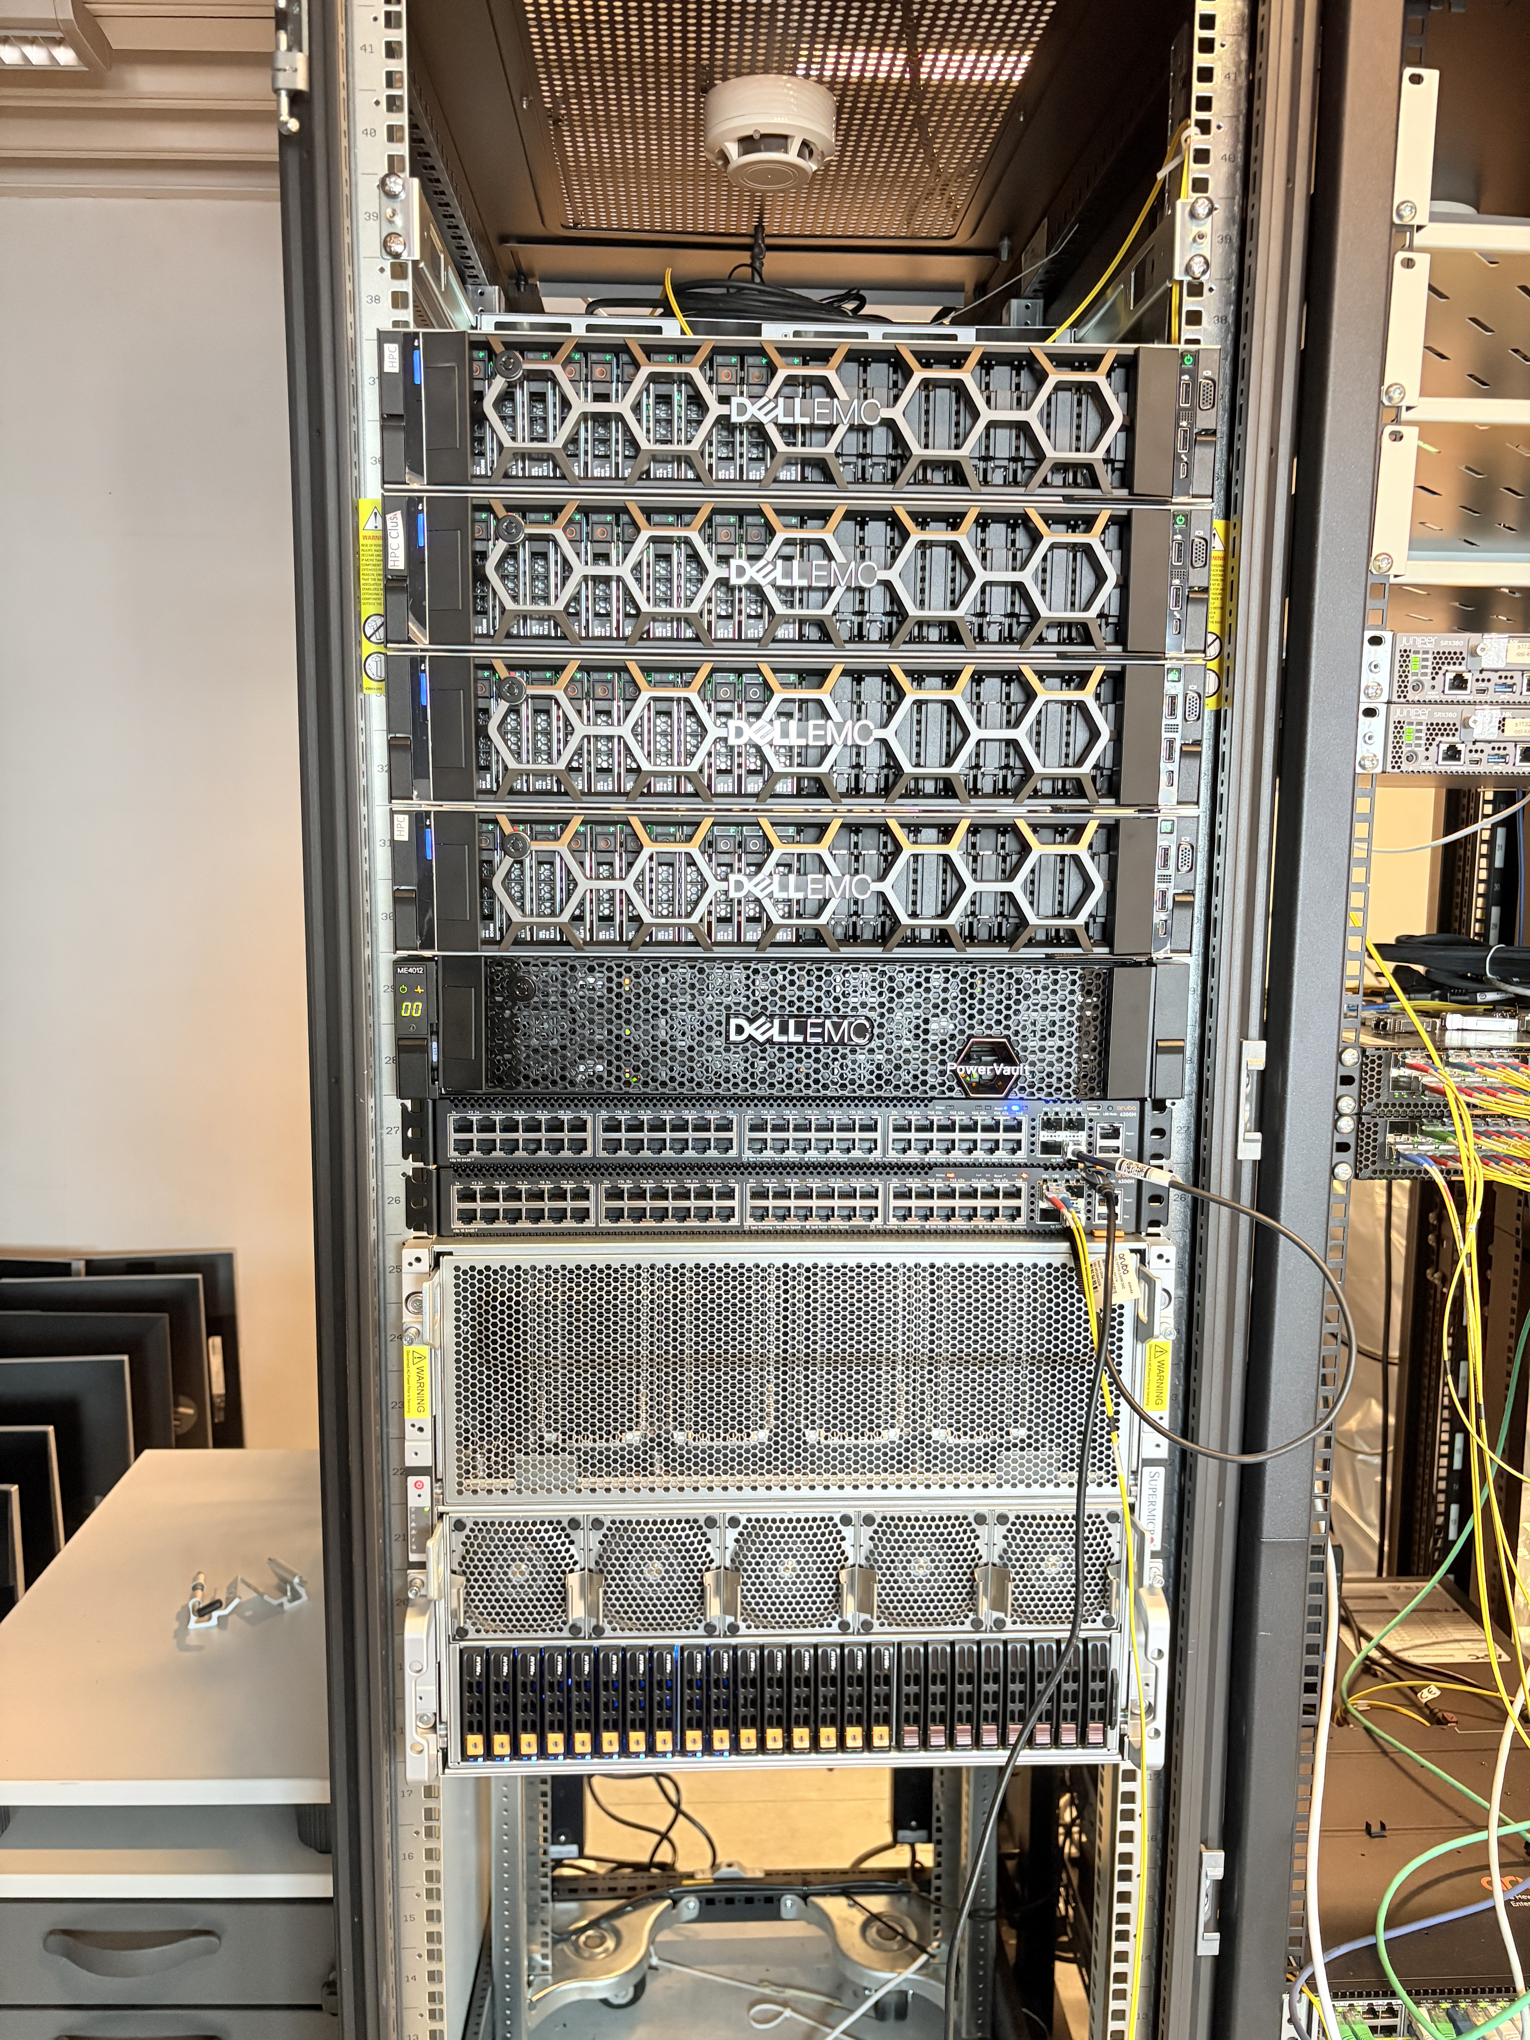
Kristiania HPC with GPU power for Research
Presenter:
Guru Bhandari
GPU node
HPC

Slide 2
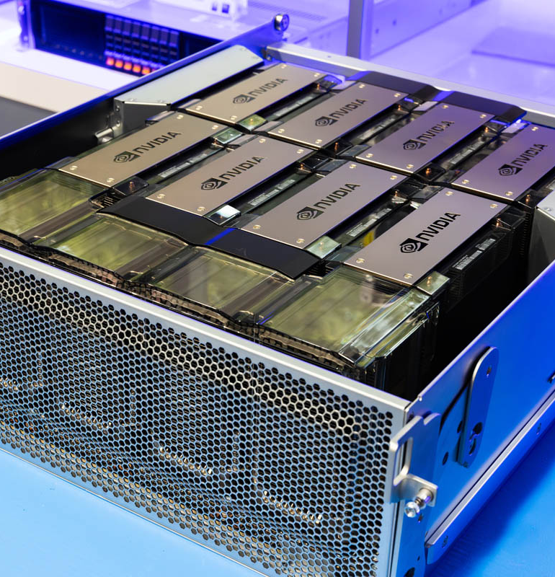
What is HPC?
High Performance Computing = Many computers working together to solve big problems.
Much faster than normal computers.
Why GPU?
A Graphics Processing Unit (GPU) consists of a large number of processing cores, enabling it to perform numerous calculations in parallel.
Accelerates AI model training and inference
Fast processing of huge datasets (image, video, or text)

Slide 3
Applications of HPC
Scalable AI & ML Use GPU-powered deep learning for vision, language, and multimodal research; train LLMs and deploy AI pipelines for real-world tasks.
Simulation & Modeling Run complex simulations for innovation systems, supply chains, and economic analyses with parallel processing.
Cybersecurity Research Simulate threats, security models, and evaluate system resilience at scale.
Education BA/MA students get hands-on experience on industry-grade equipment.

Slide 4
Mgmt PC
Switches
Login Node
CPUQ-01 (Compute1)
CPUQ-02 (Compute2)
CPUQ-03 (Compute3)
Shared Storage
HGXQ-01 (GPU node)
What we have in HPC cluster?
Login node hosts:
Slurm scheduler
Beegfs file system
Monitoring tools
Home dir (100GB)
Login space
Internet flow
Storage node has-
Software modules
Project storage (1TB)

Slide 5
HPC specification
GPU specification
Node Name | CPUs | Memory (GB) | Sockets | Cores/Socket | Threads/Core | GPUs | Partition
epyc1 | 64 | 251 GB | 1 | 32 | 2 | 0 | CPUQ
epyc2 | 64 | 251 GB | 1 | 32 | 2 | 0 | CPUQ
epyc3 | 64 | 251 GB | 1 | 32 | 2 | 0 | CPUQ
hgx | 384 | 3023 GB | 2 | 96 | 2 | 8 | HGXQ
Feature | HGX H200 8-GPU Configuration
GPU Architecture | NVIDIA Hopper
Number of GPUs | 8x H200 SXM
GPU Memory per GPU | 141 GB HBM3e
Total GPU Memory | 1,128 GB
GPU Memory Bandwidth | 4.8 TB/s per GPU
FP8 Tensor Core Performance | 32 PFLOPS (with sparsity)
NVLink Bandwidth per GPU | 900 GB/s
Note:
Epyc1, 2 and 3 have Dell PowerEdge R7515 AMD 7542 2.9PGz, 32C/64T128M, 225W, 3200 in each.
Persistent storage: Dell EMC ME4012 Storage Array 192TB hard drives
Dell EMC S4112 for networking

Slide 6
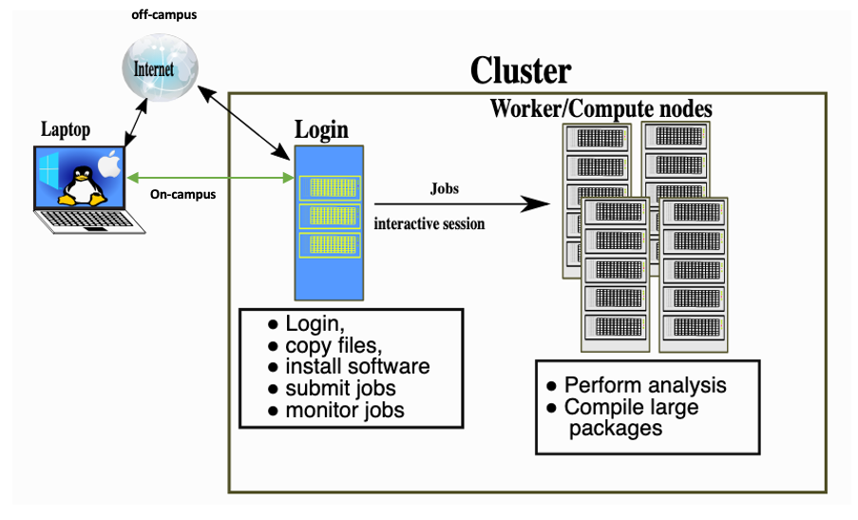
Workload management
Source: https://training.pages.sigma2.no/tutorials/hpc-intro/index.html

Slide 7
Benefits of using HPC:
Big data analysis
Sequential and parallel computationally expensive tasks
Collaborating in research projects
Storage and sharing of big data
Utilization of high bandwidth
Time saving
Security

Slide 8
Who can use the Kristiania-HPC infrastructure?
Users: Graduate students, PhD students, researchers, and employees
Groups: Projects or Labs
Storage: Home dir - 100GB, and project dir – 1TB
Accessibility: user-level, project-level, and admins

Slide 9

Additional information on HPC
A separate email address for HPC- hpc@kristiania.no. --- granted
HPC site-
https://kristiania-hpc.github.io/
A short description and link of the HPC site to Kristiania’s research portal.
Additional resources:
Examples: https://https://github.com/kristiania-hpc/examples
Documentation: https://training.pages.sigma2.no/tutorials/hpc-intro/episodes/12-cluster.html
Training on HPC to the researchers/graduates: once in every six months (or twice).

Slide 10
How to use it?
Apply for access
SSH login
Example experiments
VScode integration
- Ingvild’s research project

Slide 11
Questions ??

